Slide 1
CGB1201 – JAVA PROGRAMMING
Department of Artificial Intelligence and Data Science
Academic Year: 2024 – 2025 (Odd Semester)
Register Number : 2303811724322114
Name : SUJITHA .R S
Year : II Year
Semester : III
Section : B
Date : 03-12-2024

Slide 2
VEHICLE MAINTENANCE SYSTEM

Slide 3
Problem Identification
1. Inefficient Scheduling and Resource Allocation: Inefficient scheduling and resource allocation lead to delays, increased labor costs, and reduced productivity.
2. Inadequate Record-Keeping and Tracking: Incomplete or inaccurate maintenance records make it difficult to access and manage vehicle maintenance history.
3. Lack of Real-Time Alerts and Notifications: Delays in scheduling maintenance and increased downtime occur due to the lack of real-time alerts and notifications.

Slide 4
Objective
To ensure timely and efficient maintenance of vehicles
To reduce downtime and increase vehicle availability
To improve maintenance scheduling and resource allocation
To enhance customer satisfaction and loyalty
To reduce maintenance costs and improve overall operational efficiency

Slide 5
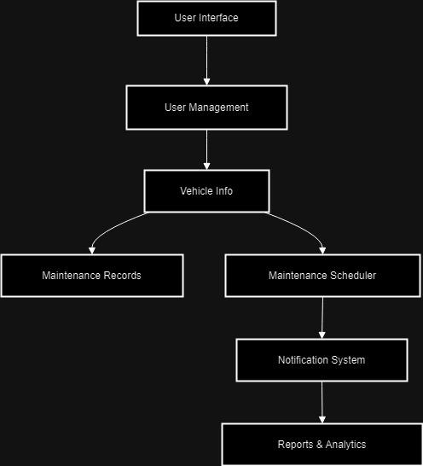
Proposed Architecture

Slide 6
Java Programming - Concepts Used
Classes and Objects classes:can be created to represent different types of vehicles.
Inheritance: can be used to create a hierarchy of vehicle classes.
Encapsulation:can be used to hide the implementation details of the vehicle objects from the outside world.
Abstraction:can be used to show only the necessary information to the user while hiding the implementation details.
Scanner class.
Hash map.

Slide 7
List of Modules
Module 1: Vehicle Management.
Module 2: Technician Management.
Module 3: Reporting and Analytics.
Module 4: Security and Access Control.
Module 5: Mobile App.

Slide 8
Module Description
Module 1: Vehicle Management
- Vehicle registration and profile management
- Vehicle information management (make, model, year, etc.)
- Vehicle classification (car, truck, motorcycle, etc.)
- Vehicle status management (active, inactive, etc.)
Module 2: Technician Management
- Technician profile creation and management
- Technician scheduling and assignment
- Technician performance tracking and reporting
- Technician certification and training management

Slide 9
Module Description (Cont..)
Module 3: Reporting and Analytics
- Reporting and analytics for vehicle maintenance data
- Reporting and analytics for maintenance history and schedules
- Reporting and analytics for inventory management
- Reporting and analytics for technician performance and customer satisfaction
Module 4: Security and Access Control
- User authentication and authorization management
- Role-based access control for system modules and features
- Data encryption and secure storage management
- Audit trail and logging management

Slide 10
Module Description (Cont..)
5: Mobile App
- Mobile app development for vehicle owners and technicians
- Mobile app features for vehicle maintenance scheduling and tracking
- Mobile app features for technician assignment and management
- Mobile app features for customer communication and notification.

Slide 11
Source Code
import java.awt.*;
import java.awt.event.*;
import java.util.ArrayList;
class VehicleMaintenanceSystem extends Frame implements ActionListener {
// GUI Components
Label lblTitle, lblVehicle, lblTask, lblDate, lblReminder;
TextField txtVehicle, txtTask, txtDate, txtReminder;
Button btnAdd, btnShow;
TextArea txtArea;
// Data storage
ArrayList<String> maintenanceRecords
VehicleMaintenanceSystem() {
// Initialize the maintenance records list
maintenanceRecords = new ArrayList<>();
// Set layout and title
setLayout(new FlowLayout());
setTitle("Vehicle Maintenance System");
setSize(400, 500);
// Components for title
lblTitle = new Label("Vehicle Maintenance System");
lblTitle.setFont(new Font("Arial", Font.BOLD, 18));
add(lblTitle);

Slide 12
Source Code
// Components for adding maintenance details
lblVehicle = new Label("Vehicle Name:");
txtVehicle = new TextField(20);
lblTask = new Label("Maintenance Task:");
txtTask = new TextField(20);
lblDate = new Label("Date (YYYY-MM-DD):");
txtDate = new TextField(20);
lblReminder = new Label("Reminder (Days):");
txtReminder = new TextField(20);
// Buttons
btnAdd = new Button("Add Maintenance");
btnShow = new Button("Show Records");
txtArea = new TextArea(15, 35);
// Adding components to the frame
add(lblVehicle);
add(txtVehicle);
add(lblTask);
add(txtTask);
add(lblDate);
add(txtDate);
add(lblReminder);
add(txtReminder);
add(btnAdd);
add(btnShow);
add(txtArea);
// Add action listeners
btnAdd.addActionListener(this);
btnShow.addActionListener(this);

Slide 13
Source Code
// Window closing event
addWindowListener(new WindowAdapter() {
public void windowClosing(WindowEvent e) {
dispose();
}
});
setVisible(true);
}
@Override
public void actionPerformed(ActionEvent e) {
if (e.getSource() == btnAdd) {
// Get input values
String vehicle = txtVehicle.getText().trim();
String task = txtTask.getText().trim();
String date = txtDate.getText().trim();
String reminder = txtReminder.getText().trim();
// Validate inputs
if (vehicle.isEmpty() || task.isEmpty() || date.isEmpty() || reminder.isEmpty()) {
txtArea.setText("Please fill in all fields.");
return;
}
// Add record to the list
String record = "Vehicle: " + vehicle + ", Task: " + task + ", Date: " + date + ", Reminder: " + reminder + " days.";
maintenanceRecords.add(record);
txtArea.setText("Maintenance record added successfully!");

Slide 14
Source Code
// Clear input fields
txtVehicle.setText("");
txtTask.setText("");
txtDate.setText("");
txtReminder.setText("");
} else if (e.getSource() == btnShow) {
// Show all maintenance records
if (maintenanceRecords.isEmpty()) {
txtArea.setText("No maintenance records found.");
} else {
StringBuilder records = new StringBuilder("Maintenance Records:\n");
for (String record : maintenanceRecords) {
records.append(record).append("\n");
}
txtArea.setText(records.toString());
}
}
}
public static void main(String[] args) {
new VehicleMaintenanceSystem();
}
}

Slide 15
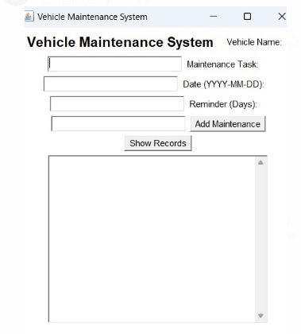
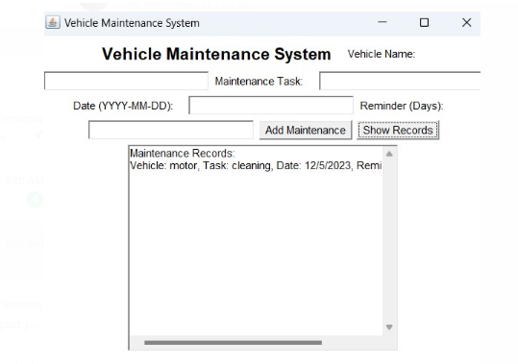
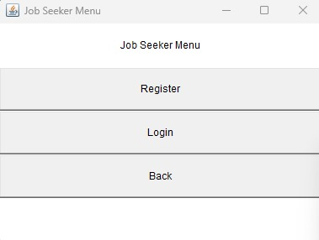
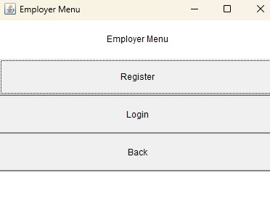
Results

Slide 16
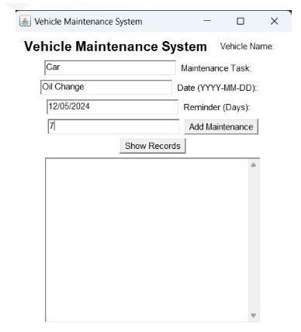
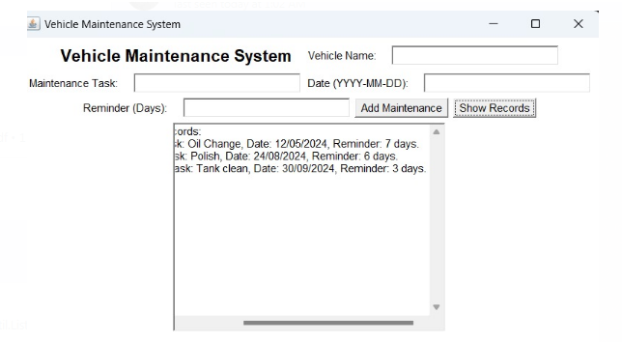
Results

Slide 17
Conclusion
The system simplifies vehicle maintenance.
Supports both individual and fleet needs.
Ensures timely service reminders.
Promotes efficient management practices.
Helps reduce costs and increase vehicle longevity.

Slide 18
Thank You
ANY QUERIES???

